Slide 1



Integrated Program in Business Analytics
IT Incident Tickets Analysis
IPBA Group J
Trending and Forecasting

Slide 2
Agenda
Business Problem and Objectives
Data Overview
Data Definition
Data Preparation
Exploratory Data Analysis
Feature Engineering
Pre-Processing and Modelling
Prediction and Conclusions
Businesss Recommendations

Slide 3










Group Members
Anshuman Tewary
Praveen L Uppunda
Raj Rane
Sandeep Chandran
Satyajit Jindam
Shailendra Tiwari
Siladitya Mukherjee

Slide 4
Data Sources
Business Problem and Objectives
Understand ticket trends and forecast staffing/resource requirements
Forecast staffing requirements/ resource allocation based on
Monthly tickets created
Shift patterns
Products
Data is self sourced
NDA Requirements
NDA not required as data is self sourced

Slide 5
Data Overview
Incident tickets created from 2016 through 2022 based on Priority P0s through P5s
Data has information on tickets created corelated with products and shifts
It has information on how many engineers worked on these tickets
We had 42 columns and 20,96,919 rows items in totality
From this main dataset we created a data frame of 11 Columns

Slide 6
Data Definition
Column Name | Definition
Number | Ticket Number prefixed with priority
Category | Ticket category based on automation logic or choice of ticket creator
Type | Within category, type of issue
Item | Within Category and Type, final categorization of issue as item
Product | Service or Product the issue can be categorized as
Created Date Time | Date and time when the ticket was created
Created Date | Date when the ticket was created
Created MMM-YY | Month year when ticket was created
Created By | Who created the ticket
Created by Category | Category of ticket creator
Time to Assign | Time taken by an engineer when the ticket gets assigned
Time to Assign (Hours) | Time taken by an engineer when the ticket gets assigned in hours
Time to Assign SLA | Was the ticket assigned within SLA
Assigned To | Engineer to whom the ticket was assigned
Assignment Group | Assignment group under which the engineer was assigned to this ticket
Resolved At | When was the ticket resolved
Time to Resolve | Time taken to resolve the ticket in hours and minutes
Time to Resolved (Hours) | Time taken to resolve the ticket in minutes
Time to Resolve SLA | Was the ticket resolved within SLA
Resolved By | Who resolved the ticket
Time to Service Restore | Time taken to restore the ticket in hours and minutes
Column Name | Definition
Service Restore End | Date and time when the ticket was restored
Service Restore Duration (Hours) | Time taken to restore the ticket in minutes
Service Restore Date | Date when the ticket was restored
Service Restored MonthYear | Month year when ticket was restored
Root Cause L1 | Root cause level 1 of the Incident
Root Cause L2 | Root cause level 2 of the Incident
Root Cause L3 | Root cause level 3 of the Incident
State | Current State of the ticket
Status | Current Status of the issue
Aging Hours | Total hours ticket was open - from created to closed state
Age Days | How many days ticket was open
Age Bucket | Bucket based on ticket age
Closed | Ticket closed date and time
Closed By | Who closed the ticket
Company | Company under which the ticket was opened
Device Name | Device name
Device Type | Device type
Device Status | Device status
Device Managed Status | Device managed status
Internal/External | Internal or customer ticket
Reassignment Count | Number of times the ticket has been reassigned

Slide 7
Data Preparation
Identified all null values in the table
Tickets without closed dates were determined to be outliers and removed as they constituted 1.75% of the total ticket population
Induced Created Month-Year column based on Created Date to get monthly count of tickets created
Added Shift column based on ticket’s created time
Formulated Closed Month-Year column based on Closed date
Extracted Priority from the ticket number column

Slide 8
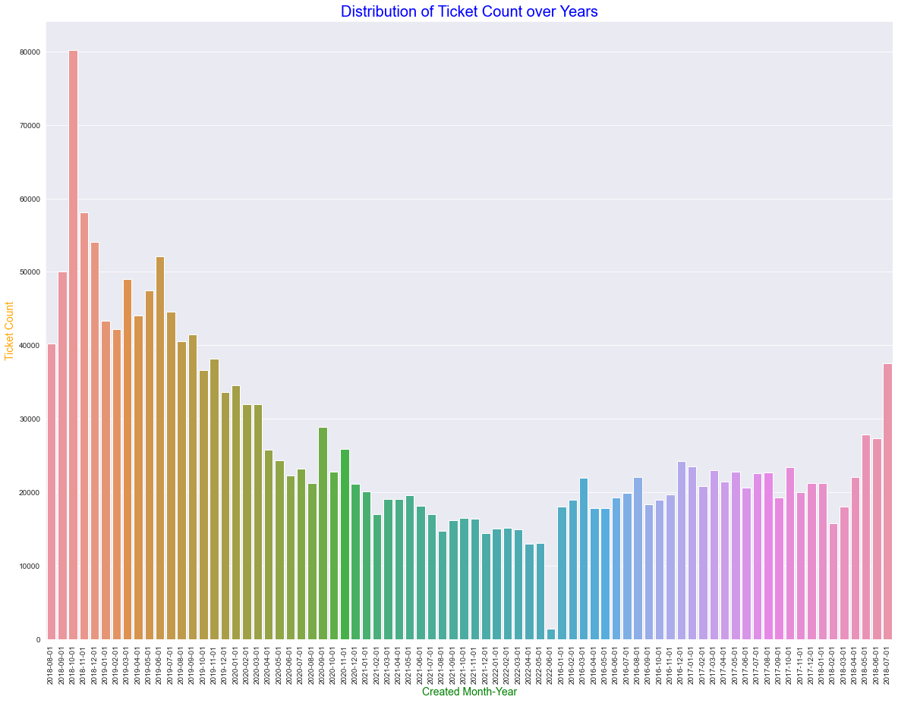
Exploratory Data Analysis
As part of EDA, generated bar graph for count of created tickets with respect to each month-year to understand its pattern and trend
We also created trend charts by Priority and monthly tickets created for each Product to understand our data in detail

Slide 9
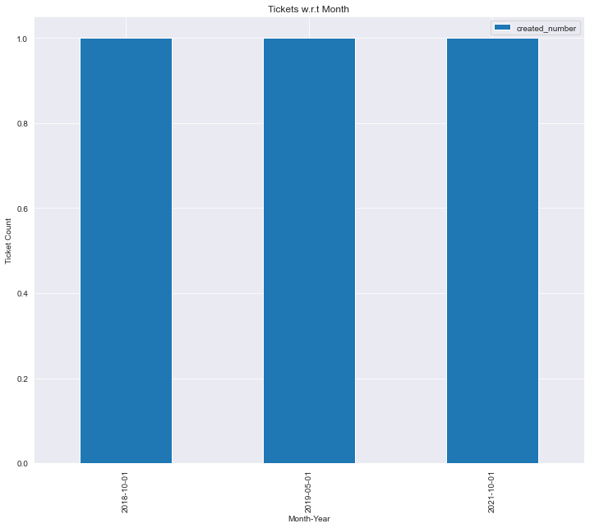
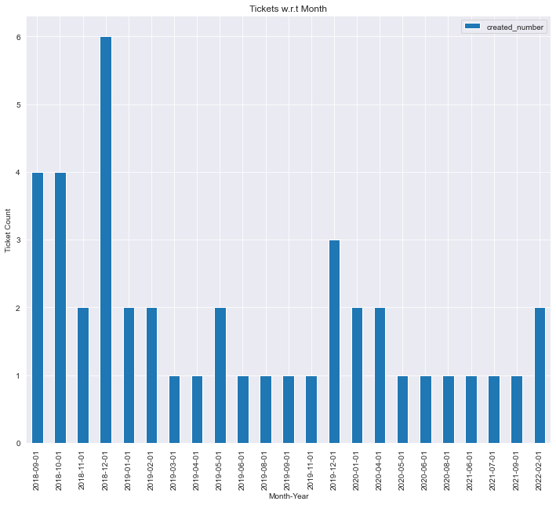
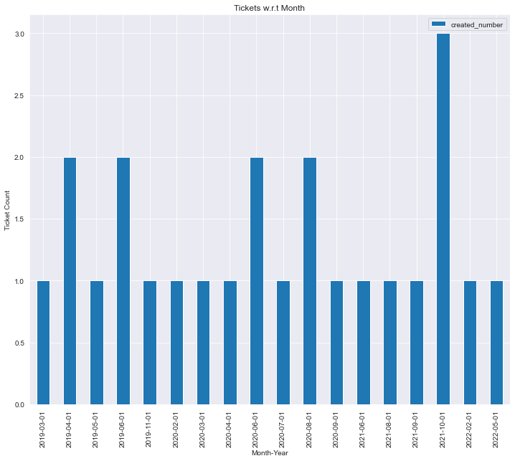
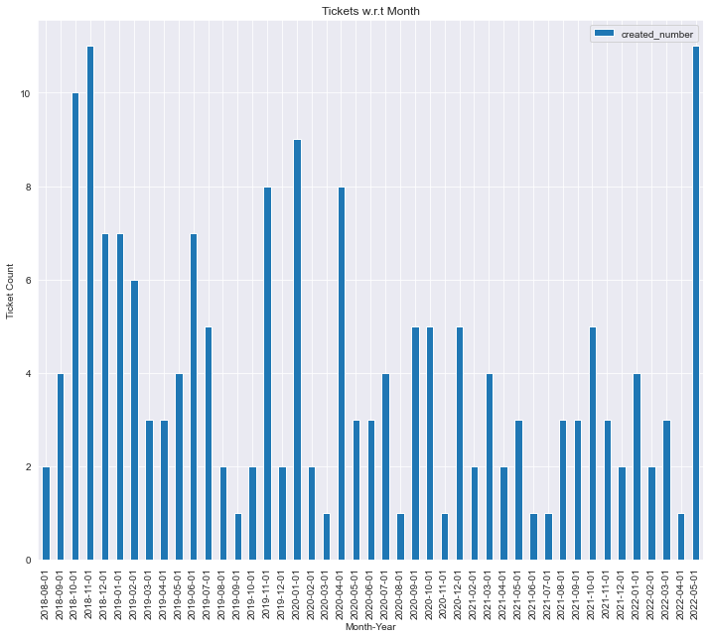
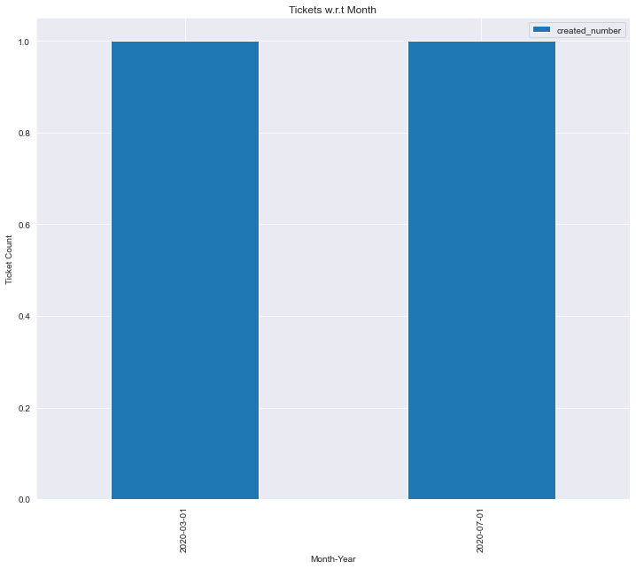
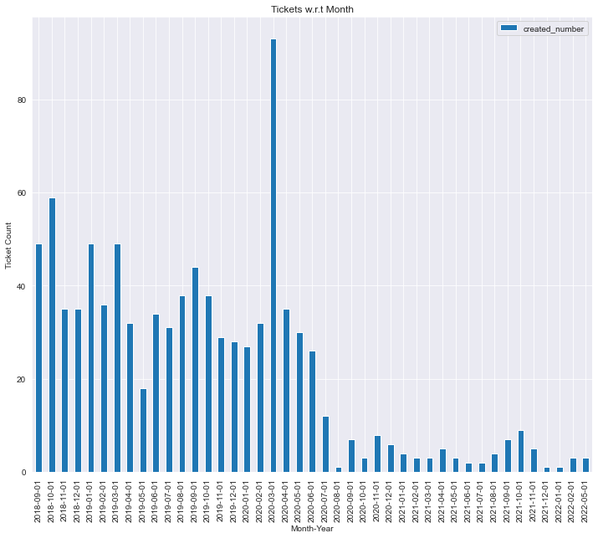
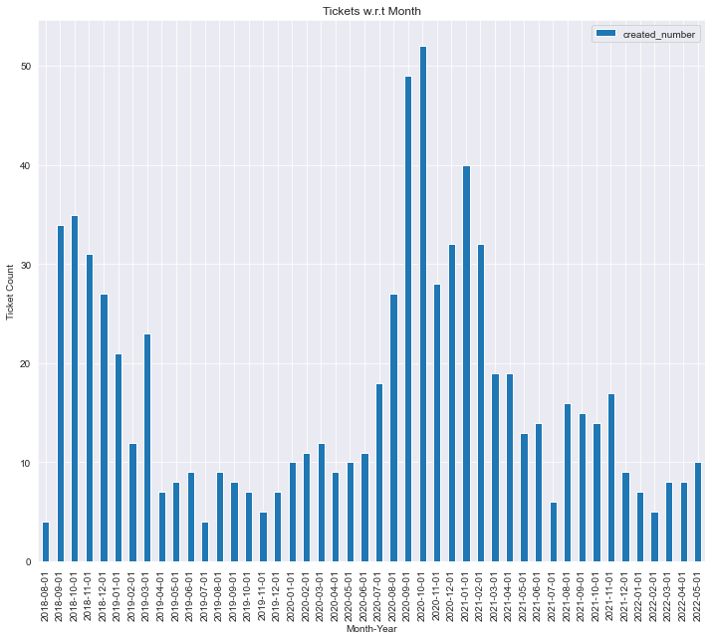
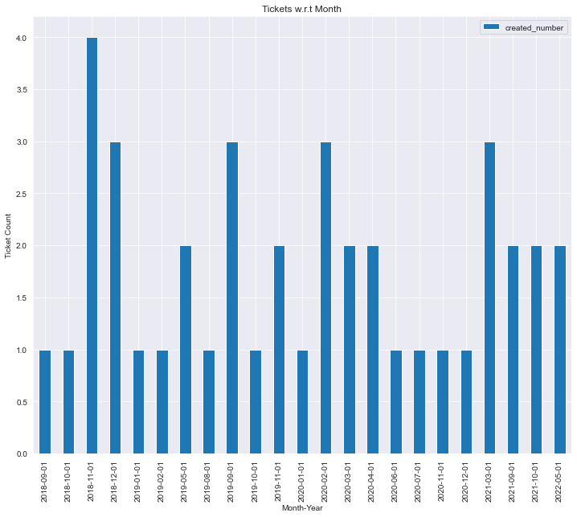
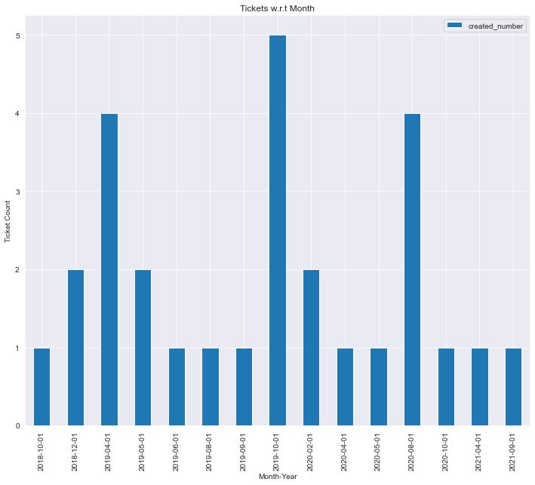
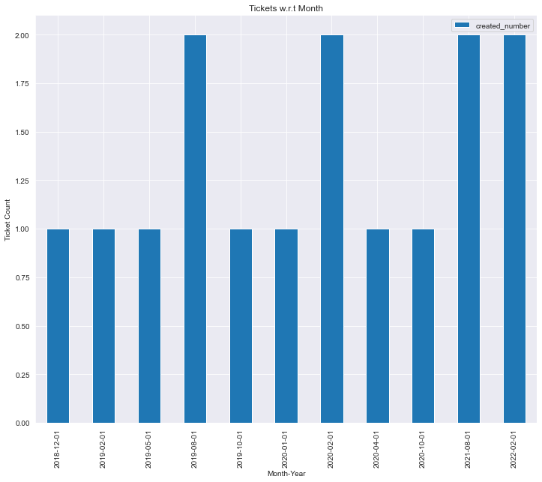
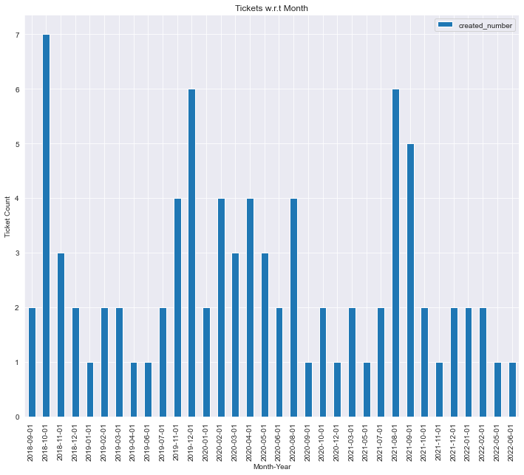
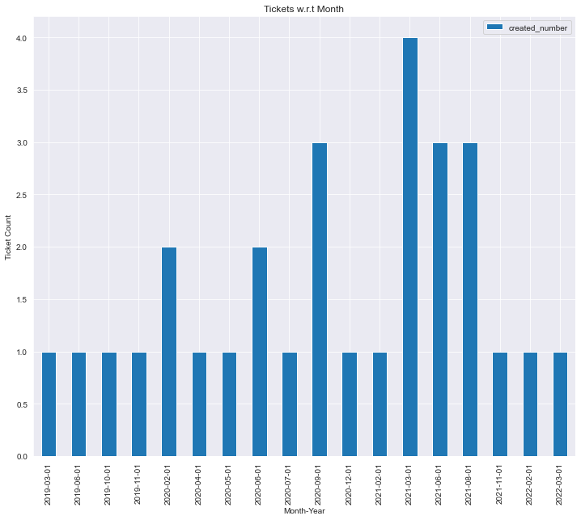
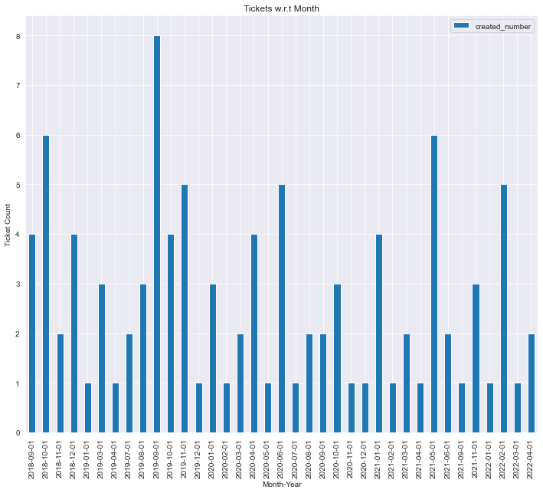
P0 Ticket Analysis
Prod 1 Prod 2 Prod 3 Prod 4 Prod 5 Prod 7
Prod 8 Prod 9 Prod 10 Prod 11 Prod 12 Prod 13
Prod 14

Slide 10
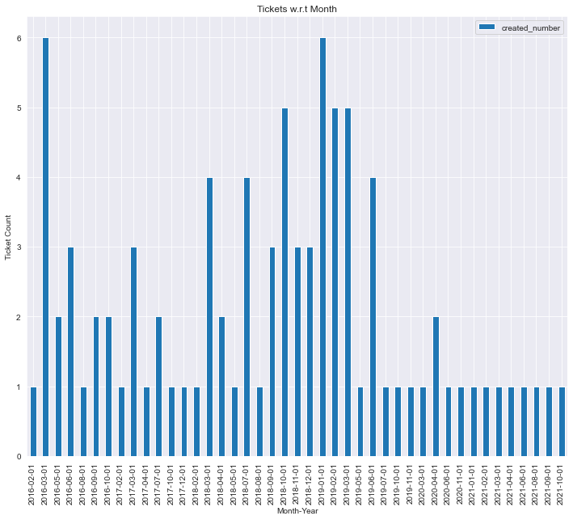
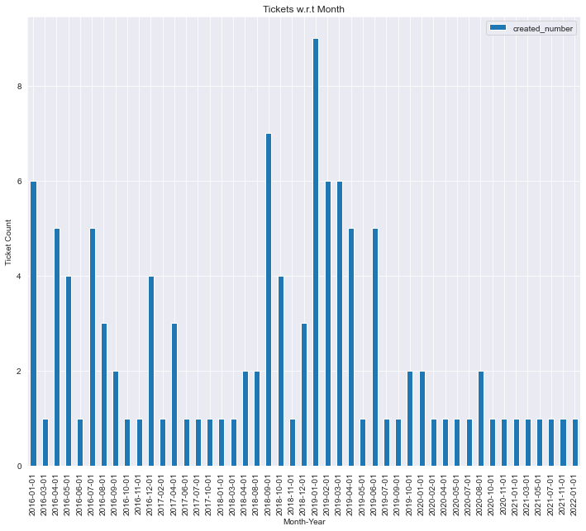
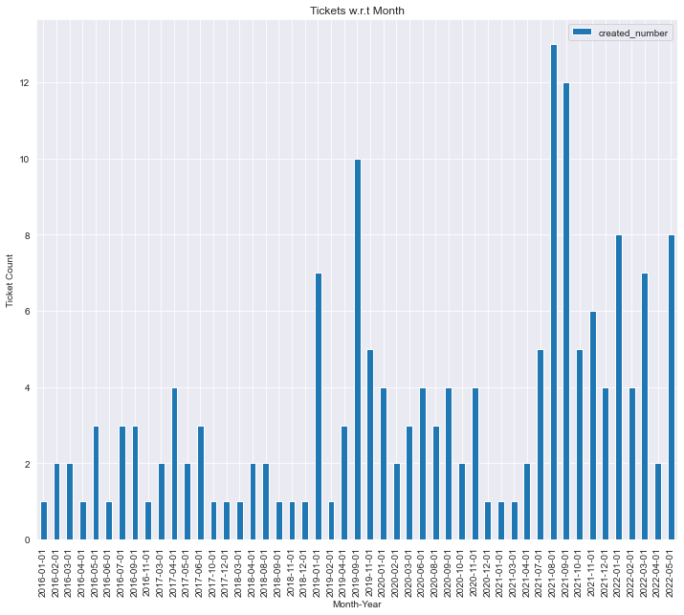
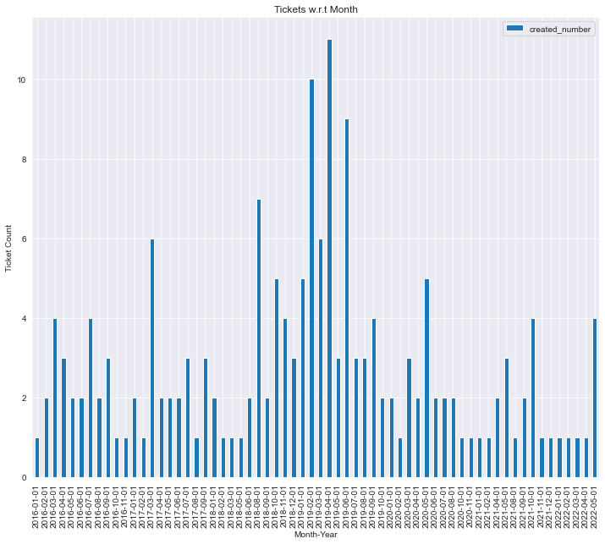
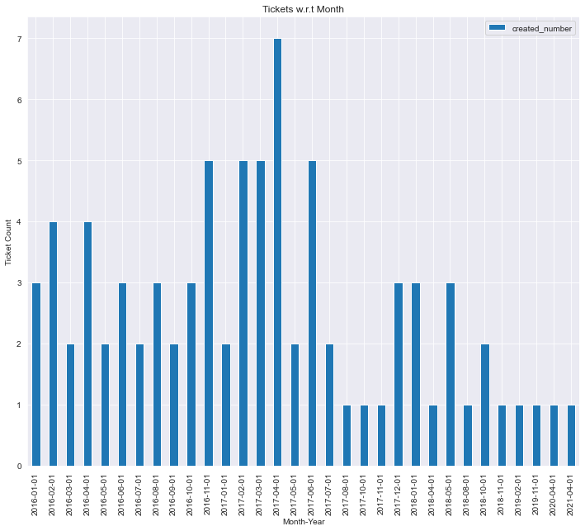
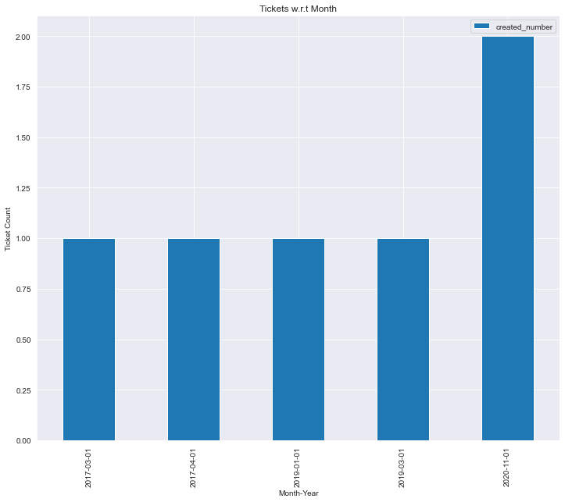
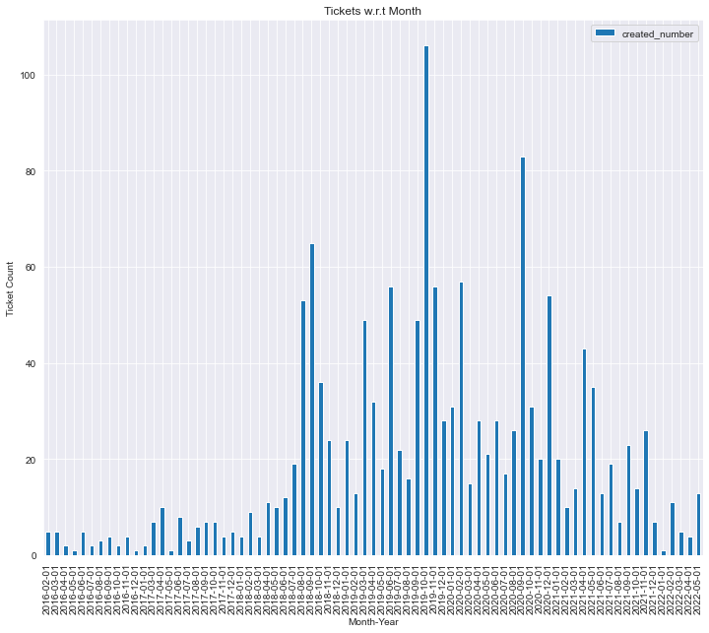
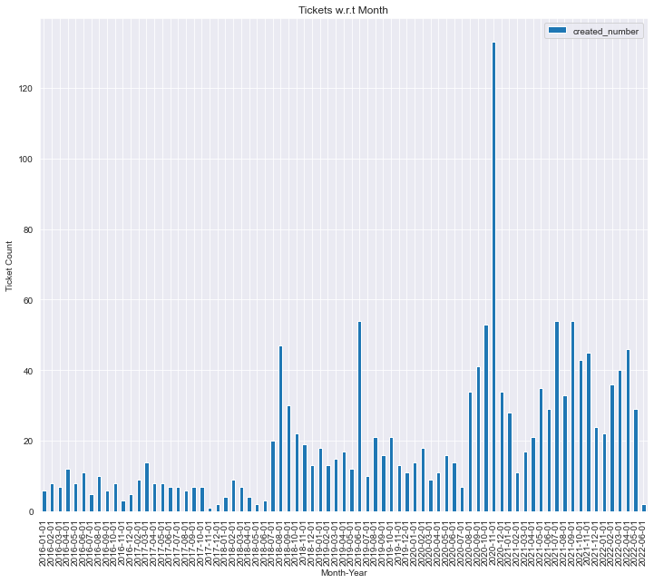
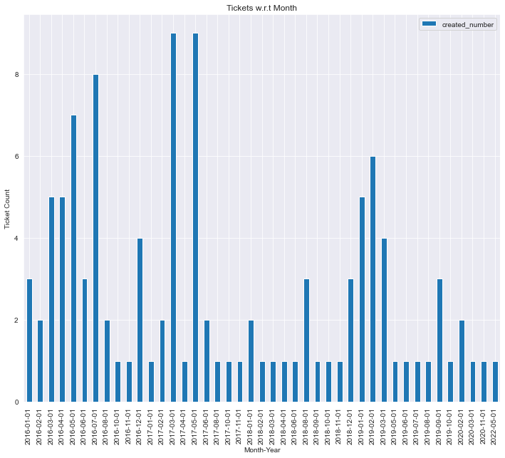
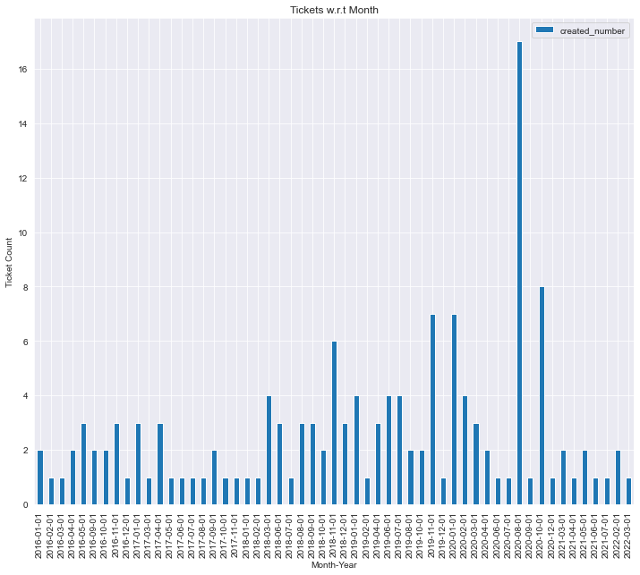
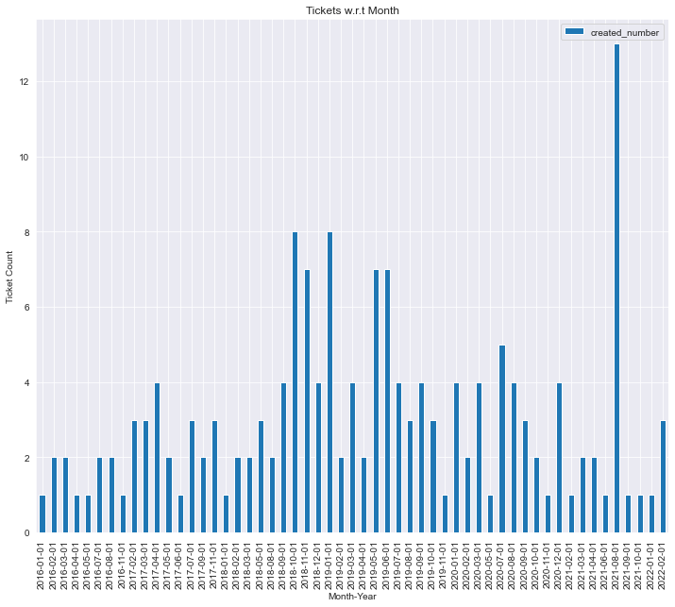
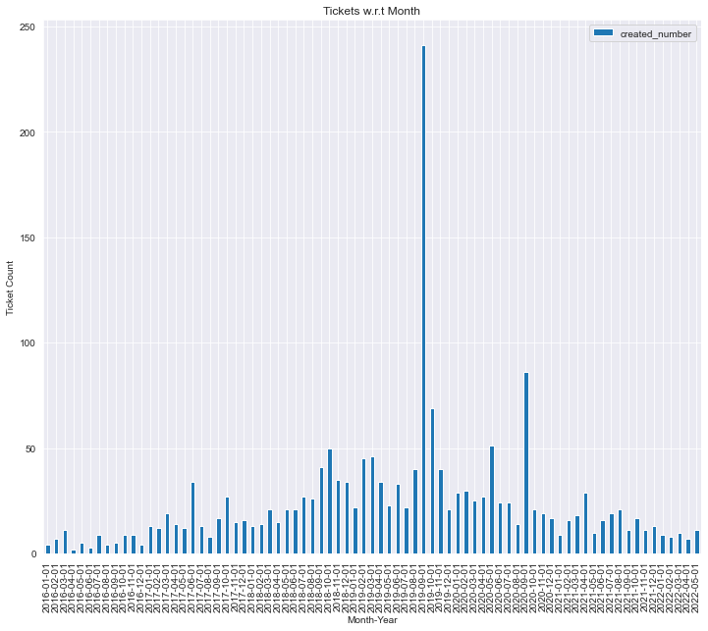
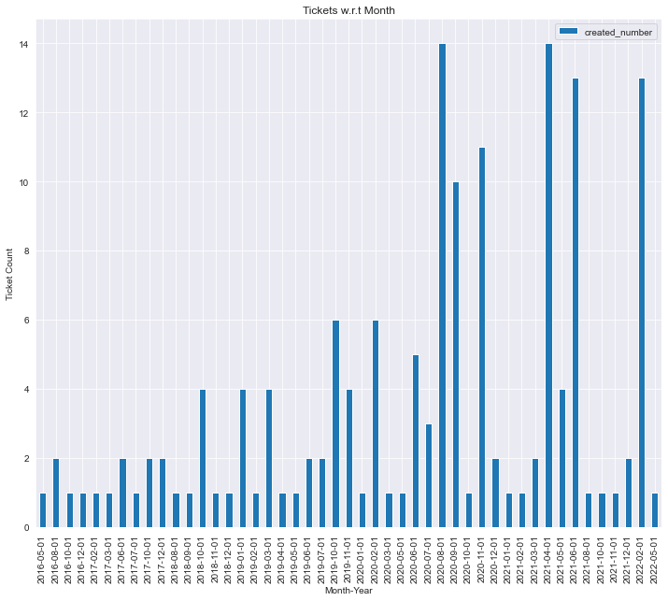
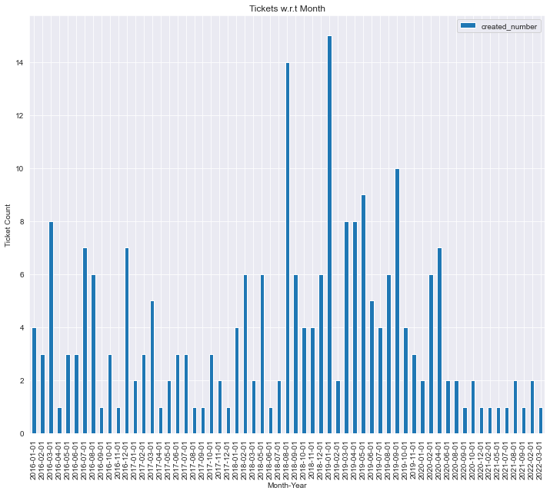
P1 Ticket Analysis
Prod 1 Prod 2 Prod 3 Prod 4 Prod 5 Prod 6
Prod 7 Prod 8 Prod 9 Prod 10 Prod 11 Prod 12
Prod 13
Prod 14

Slide 11
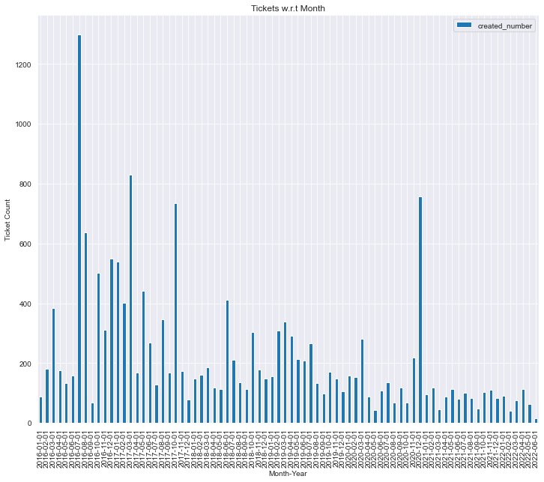
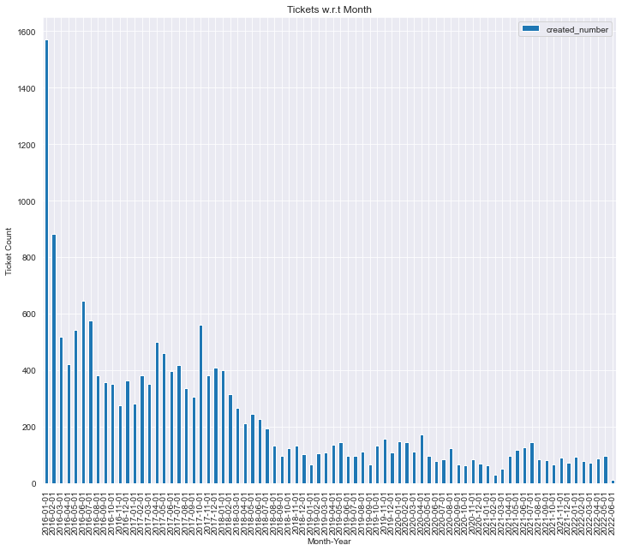
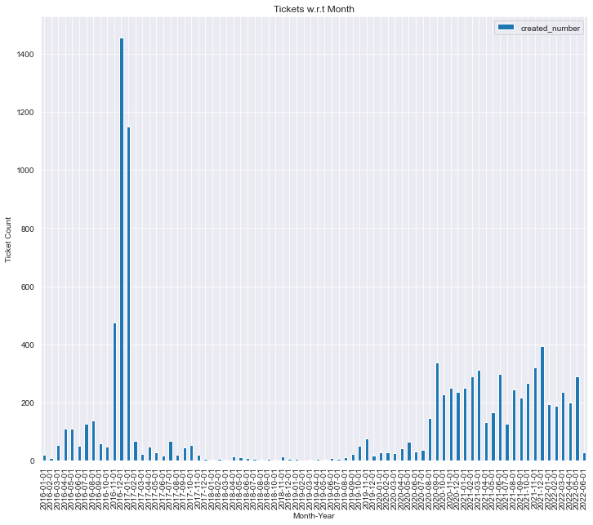
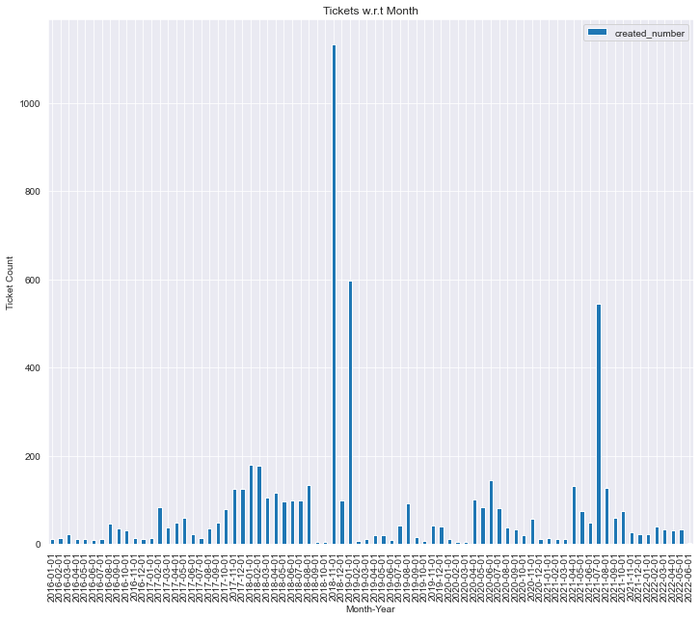
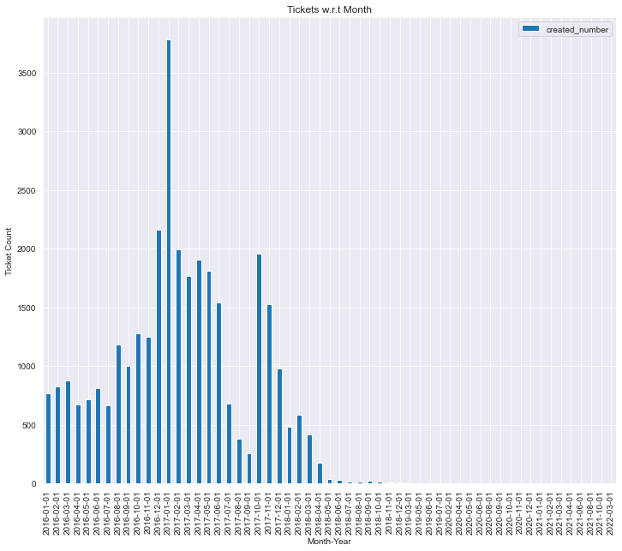
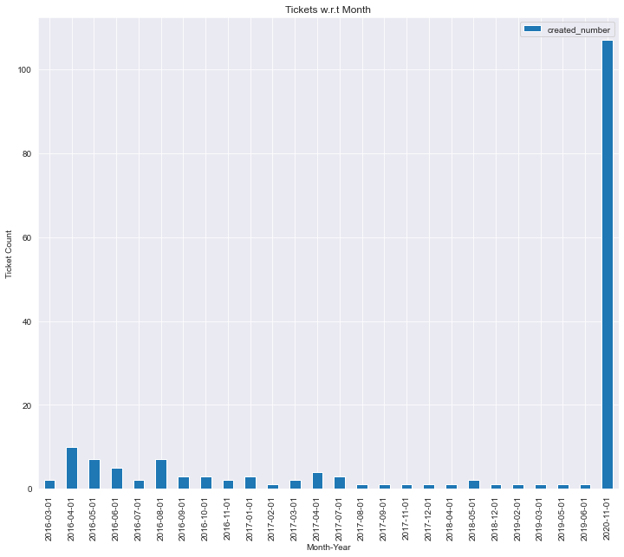
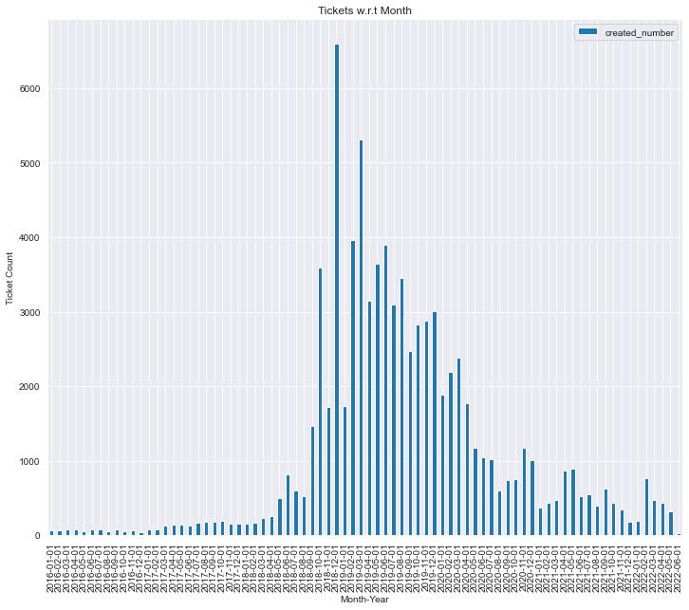
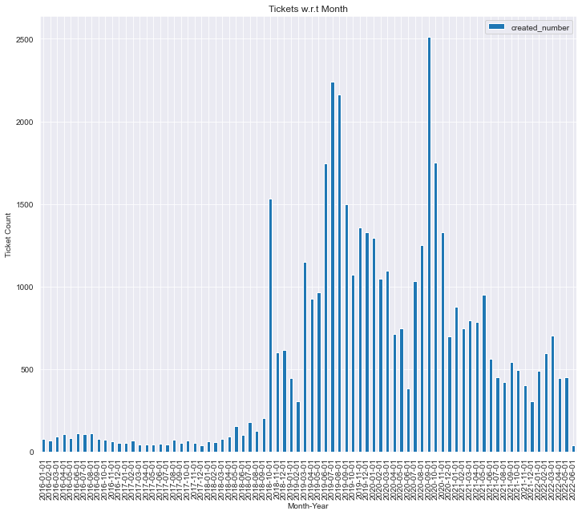
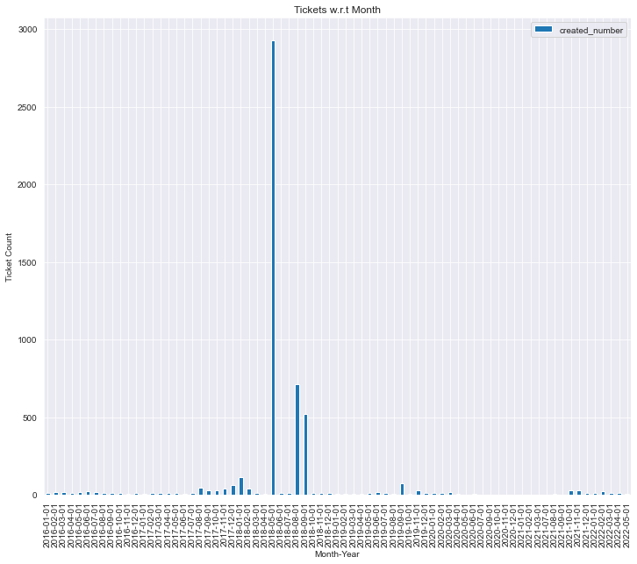
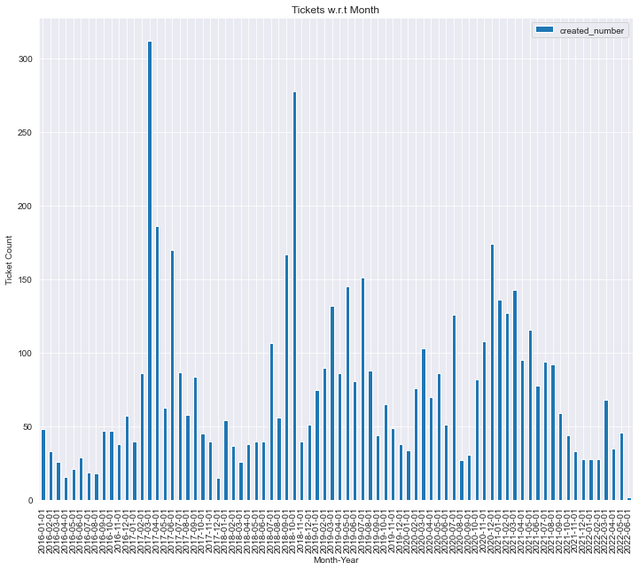
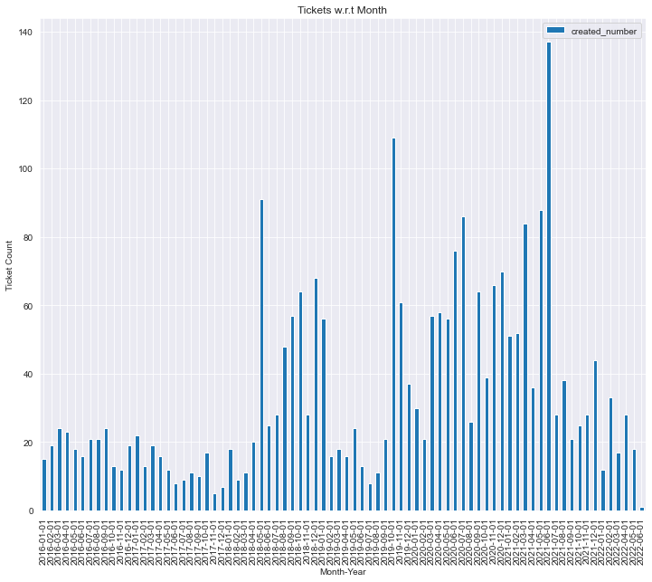
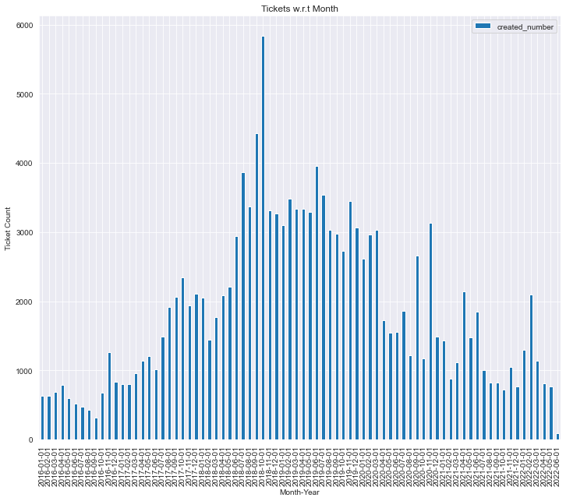
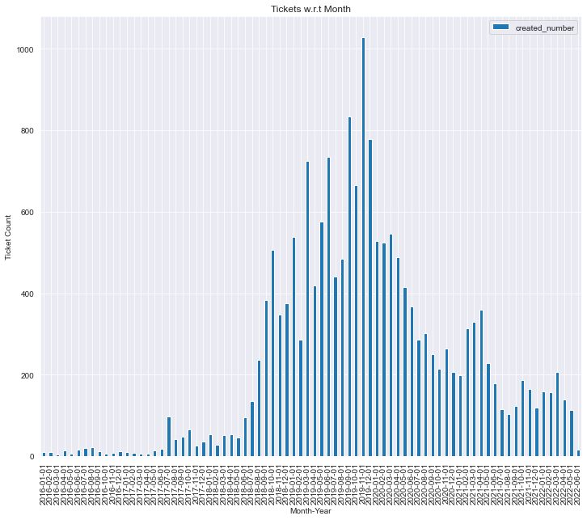
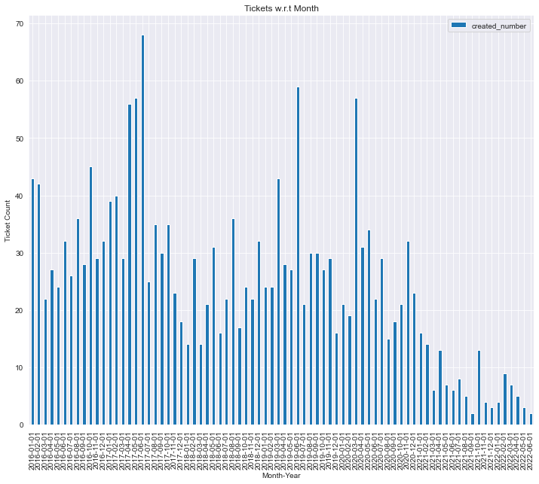
P2 Ticket Analysis
Prod 1 Prod 2 Prod 3 Prod 4 Prod 5 Prod 6
Prod 7 Prod 8 Prod 9 Prod 10 Prod 11 Prod 12
Prod 13
Prod 14

Slide 12
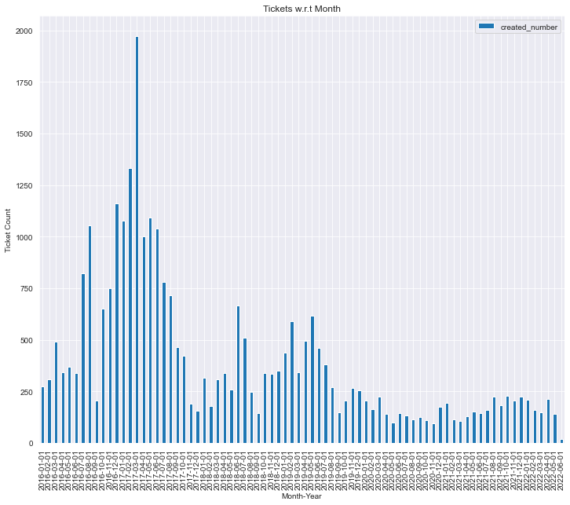
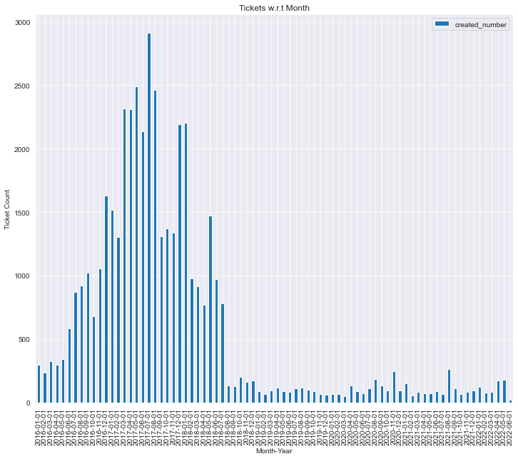
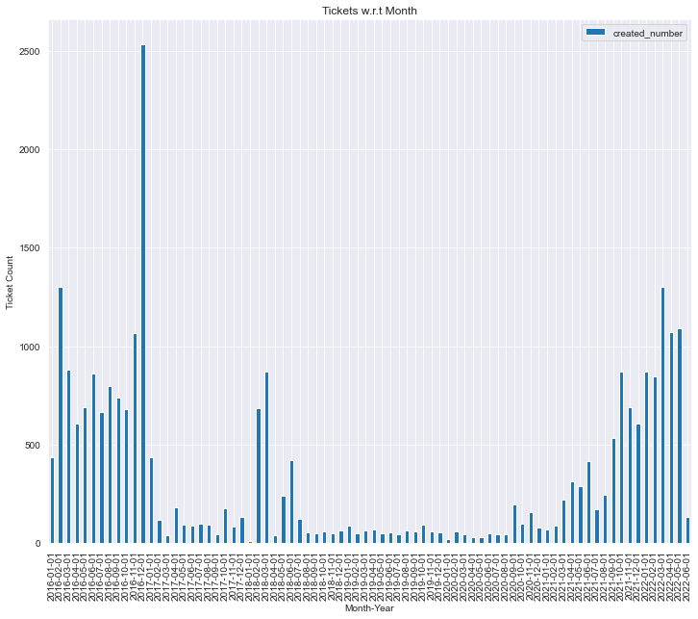
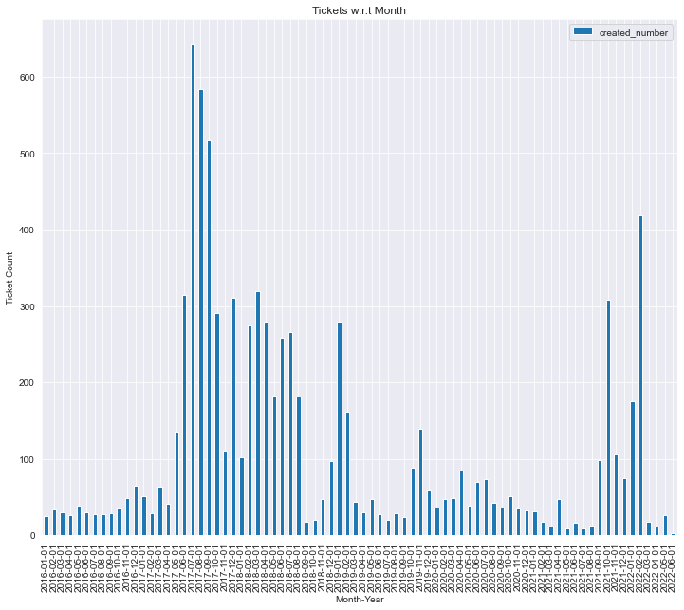
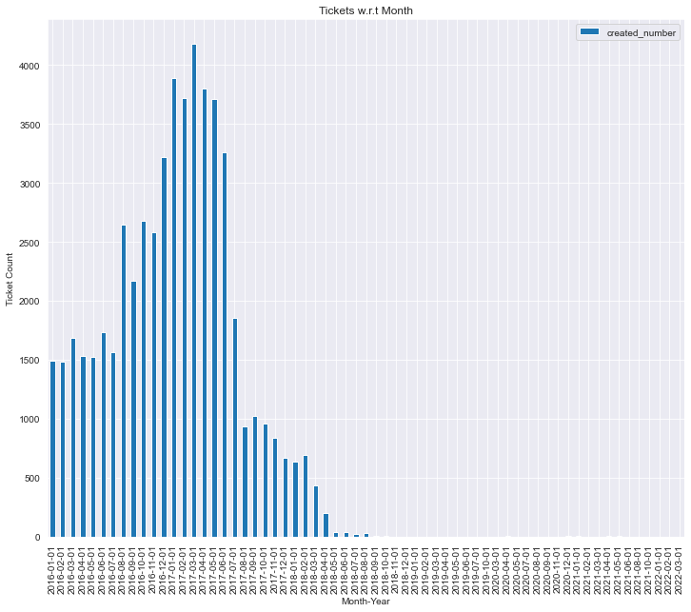
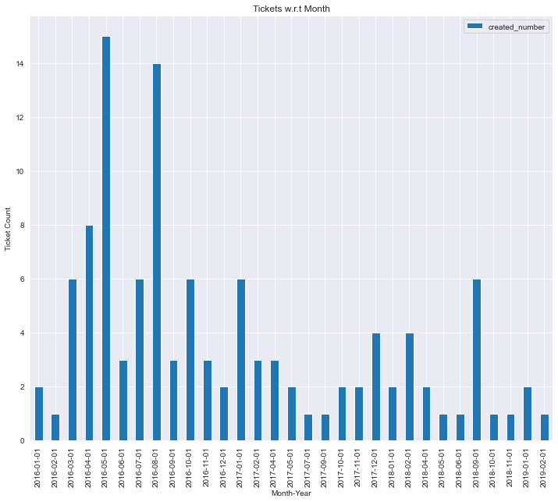
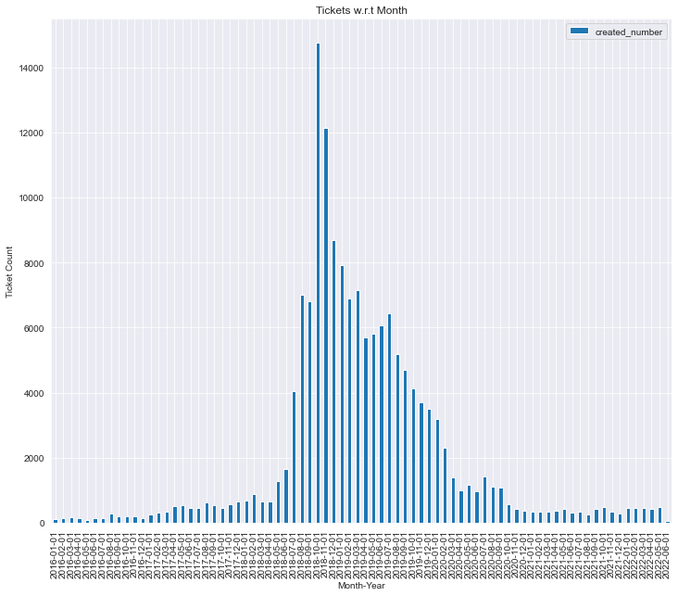
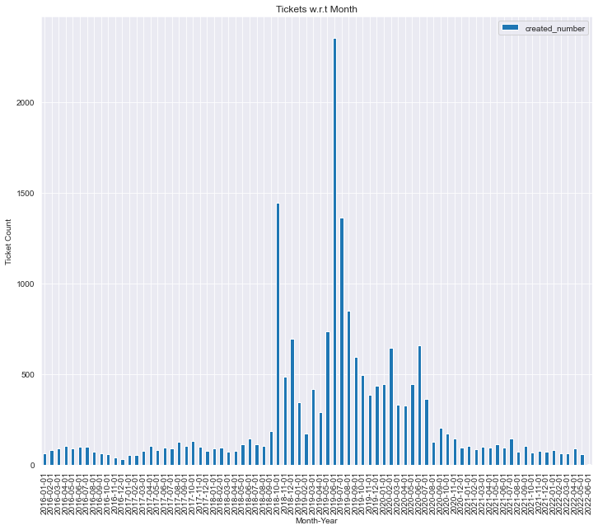






P3 Ticket Analysis
Prod 1 Prod 2 Prod 3 Prod 4 Prod 5 Prod 6
Prod 7 Prod 8 Prod 9 Prod 10 Prod 11 Prod 12
Prod 13
Prod 14

Slide 13














P4 Ticket Analysis
Prod 1 Prod 2 Prod 3 Prod 4 Prod 5 Prod 6
Prod 7 Prod 8 Prod 9 Prod 10 Prod 11 Prod 12
Prod 13
Prod 14

Slide 14













P5 Ticket Analysis
Prod 1 Prod 2 Prod 3 Prod 4 Prod 5 Prod 6
Prod 7 Prod 8 Prod 9 Prod 10 Prod 11 Prod 12
Prod 14

Slide 15
Exploratory Data Analysis
We learned P0 tickets are not created uniformly for all Products
P1 tickets are fairly concentrated for majority of the Products
P2 tickets have sporadic spikes, they are on an average below 50% of the ticket population
P2 and P3 have bigger share, 72.4%, of the ticket population
Products 12, 3 and 4 have maximum tickets across P0-P4 priorities

Slide 16
Feature Engineering
Based on business requirements below features were considered to create condensed data frame
Tickets without closed dates were determined to be outliers and removed
From the main dataset we created a data frame of 7 Columns and 12,100 rows
We considered following columns for our data frame
date - Its ticket created month and year
product - 15 categories of Service or Product the tickets were categorized
shift - 3 Shifts of 8 hours each from 0 through 24 hours were created based on ticket Created date
Priority - Impact and Severity of the issue
created_count - Count of tickets created in a given month
assigned_to - Person the ticket is assigned to
closed_count - Count of tickets closed in a given month
One-hot encoding technique was used to convert categorical data to numerical data for further processing and modelling
Continued…

Slide 17
Feature Engineering
2 data frames were created to compute Created & Closed counts
These data frames were further merged based on following combination
Date
Shift
Priority
Product
All null values in created and closed count columns were replaced with 0 as null meant no tickets were created or closed for aforementioned combination

Slide 18

Pair Plots
Pair plots were done to identify the relationship between the features of the final data frame through visualizations
Created and Closed counts has linear relationship
Since Created and Closed counts have linear relationship, Assigned To is not highly corelated with them
However the Assigned To’s relation with Created and Closed counts are same or similar

Slide 19



Line Plots
Created Count
Line plots were created to identify trends and check if they coincide with the super data set trend
All 3 features followed trend of super data set
Closed Count
Assigned To Count

Slide 20

Correlation Map
Created and Closed counts have high positive correlation
Assigned to has low correlation with Created and Closed counts

Slide 21
Pre-Processing and Modelling
For forecasting we choose 1 year's data from June 2021 through June 2022
Decision Tree, XGBoost and Linear Regression algorithms were chosen to decide best suitable model for accuracy
Among the three aforementioned models Linear Regression was more accurate
Pareto principle (80:20) was used to split data between training and test model
The model was trained on training data set and tested for prediction on test data set for created ticket counts
Results were compared with test output and accuracy was computed to be 98%
Linear Regression was also used for headcount requirement

Slide 22


Prediction and Conclusions
Number of tickets created are gradually decreasing
Tickets prediction based on train and test model remain true to the trend for entire data set
Only P2 tickets had a predicated slight increase in count
Shift prediction also follows trend and predicts decrease in Created tickets
Mean Absolute Error in headcount resource prediction resulted to be ± 6 (9%) and we aim to improve it to ± 3 (4%)

Slide 23






Prediction and Conclusions

Slide 24



Prediction and Conclusions

Slide 25

Prediction and Conclusions

Slide 26
Business Recommendations
The team recommends to continue with current headcounts for next month
Recommend to focus on products 4, 7, 8, 12 and 14 as they have maximum high impact tickets
Product 6 has minimum tickets hence it’s the best performing service

Slide 27
Thank You

